Slide 1
Scrum Overview

Slide 2
What is Scrum
A framework which can address complex adaptive problems and help teams be productive and creative in delivering products of the highest possible value
Scrum is – lightweight, simple to understand, but difficult to master
Scrum is a process framework not a process or technique for building products. Scrum is a framework within which you can employ various processes and techniques.
Each component of the framework serves a specific purpose and is essential to scrum’s success and usage
-The Scrum Guide
Notes:
So what is Scrum?

Slide 3
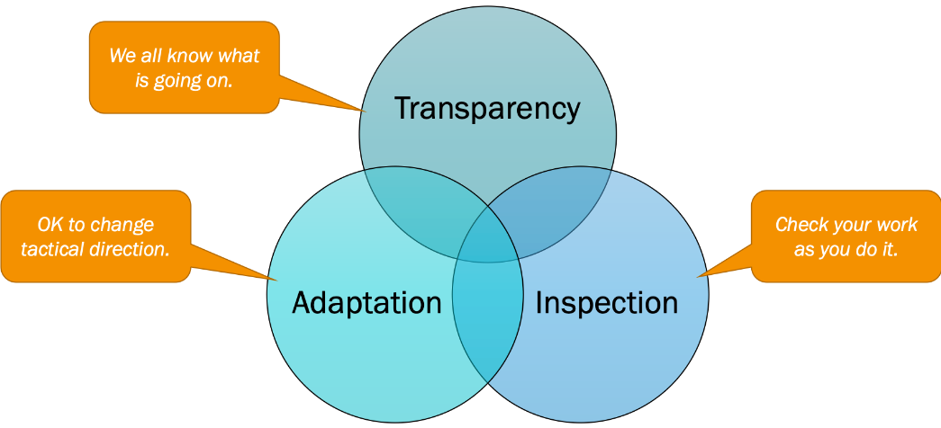
3 Principles of Scrum
Transparency – Significant aspects of the process must be visible to those responsible for the outcome. Transparency requires those aspects be defined by a common standard so observers share a common understanding of what is being seen. A shared definition of “done”
Inspection – Scrum users must frequently inspect Scrum artifacts and progress toward a sprint goal to detect undesirable variances. Their inspection should not be so frequent that inspection gets in the way of the work. Inspections are most beneficial when diligently performed by skilled inspectors at the point of work.
Adaptation – If an inspection determines an aspect of a process deviates from acceptable limits an adjustment must be made as soon as possible to minimize further deviation. Scrum prescribes four formal events for inspection and adaptation, sprint planning; daily scrum; sprint review; sprint retrospective.
-The Scrum Guide
Notes:
So what is Scrum?

Slide 4

5 Scrum Values

Slide 5
Principles and Values
Scrum Values
https://www.youtube.com/watch?v=Xu_X7KbtbV8&feature=emb_logo
Length 14:00
Length: 14:00

Slide 6
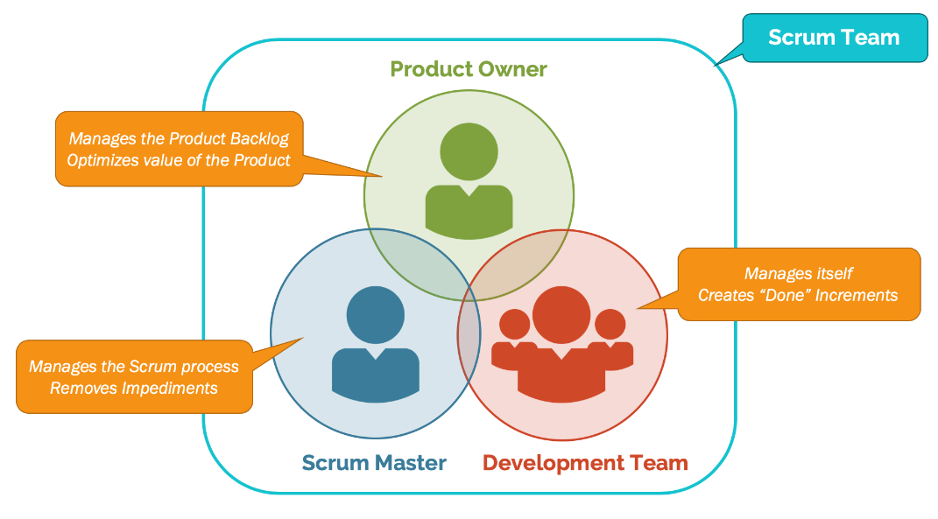
Scrum Roles
Scrum Master – servant leader that coaches, facilitates, educates, and guides the team to solve its own problems by using the 3 principles of Scrum. Allows the team to learn from the cycle of failing, trying, and failing again. Helps self-organization by removing impediments that are beyond the team’s self-organization capability

Slide 7
Scrum Roles
Product Owner – closely interacts with stakeholders and product management to identify the most valuable work. Relies on the Development Team for delivery of a potentially shippable increment every sprint. Is responsible for the product backlog (what the team will do) and the priority of the highest value items.

Slide 8
Scrum Roles
Development Team – works collaboratively to select their own work from the product backlog (items to complete), create actionable activities to create the product backlog items, re-plan work daily and deliver a potentially releasable increment.

Slide 9
Development Team
Teams are self-organizing which means no one tells the team how to turn product backlog items into potentially releasable functionality. The team decides how to do this.
Teams should be cross-functional so the team has all skills needed to deliver the final releasable product
Scrum recognizes no sub-teams within the development team, regardless of domain such as analysis or tester, the only role is that of developer
Individual development team members may have specialized skills and areas of focus, but accountability belongs to the development team as a whole
-The Scrum Guide

Slide 10
Product Vision
The Product Owner is the only person in Scrum responsible for the success of the product.
The Product Owner creates, manages, and owns the Product Vision
The Product Vision describes the purpose of a product, the intention with which the product is being created and what it aims to achieve for customers.
The product vision describes a future state of the product and what problems it tries to resolve or what ambitions it tries to fulfill.

Slide 11
Product Vision
Having a clear and inspiring product vision helps in motivating and inspiring people, such as the development team, the stakeholders, and customers.
Most importantly it provides a common understanding of the direction the team wants to move towards.
The product vision also supports the product owner in making choices about what to build and what not to build for the product
Poll: Have you ever worked on a project or product and you did not understand the goal or why you were doing what you were doing?

Slide 12
Product Backlog Items
Product Backlog Items are what make up the product backlog, they are the work that must be done
Each product backlog item can have these qualities:
Description – what is the goal of the PBI
Value – the business value of the PBI which is determined by the product owner
Estimate – the team needs to estimate the relative effort it will take to move the PBI to done
Order – the product owner needs to prioritize PBIs by their relative value
These qualities make up the definition of ready

Slide 13
User Stories
One technique used to define a product backlog item is a user story
User stories are a reminder to have a conversation, they are NOT detailed requirements
User stories are typically written on a 3x5 note card to limit the amount of details that can be written
User stories capture the feature or functionality the customer values
User stories have a format of:
As a <role>, I want to <some action or functionality>, so that <business value>

Slide 14
User Stories
User Stories also include an acceptance criteria.
The acceptance criteria explains how a customer knows the user story has been implemented.
Neither the user story nor acceptance criteria should include implementation details.
Example of user story:
As a customer, I want to pay by credit card, so I can get my order shipped sooner.
Acceptance Criteria:
Accept mastercard and visa
Do not accept American Express
Require card number, expiration date, security code, and name

Slide 15
Product Backlog Prioritization
After the product backlog is created the product owner needs to determine the prioritization
The business value portion of the user story (.. So that…) should contain the business value for the user story. This is what priority should be based on
Scrum Team reviews prioritization and makes any necessary changes for user stories that must be done before others from a technical standpoint
The result is a Prioritized Product Backlog

Slide 16
Estimation – Story Pts
The Scrum Guide does not specify a technique or method for estimating product backlog items only that they should be estimated in a relative manner
Story Points are numbers assigned to the relative size of a user story compared to other user stories
Story points have no unit of measure, they are not number of hours or number of days, just a relative number with no units
Story Points will be assigned to each user story via a technique called Planning Poker.

Slide 17
Release Planning
There are two methods to release planning either fixed scope or fixed length
Fixed scope planning determines the expected finish date by determining the number of sprints required to build all of the product backlog items
Fixed length planning picks the date and then determines the scope that can be completed in the number of sprints that can be accomplished during that period of time
Fixed length allows other stakeholders such as marketing and sales to plan for a specific due date and then get some amount of the scope completed by that date

Slide 18
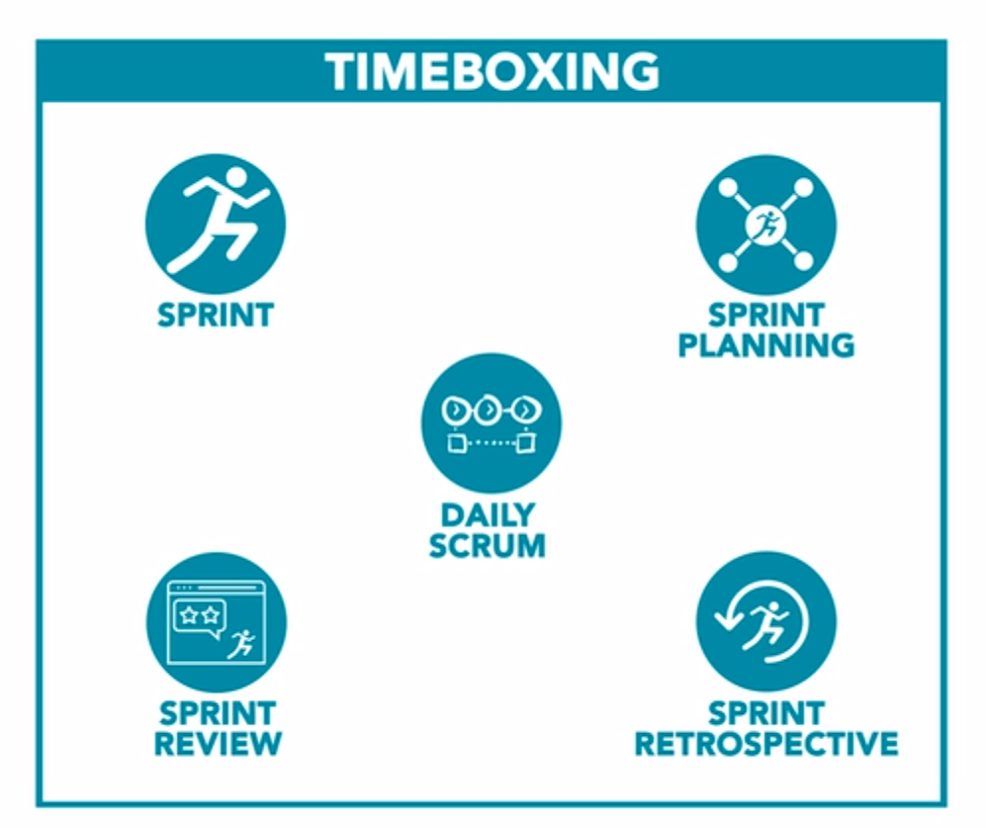
Scrum Events
Prescribed events in Scrum help to create regularity and to minimize the need for meetings not defined in scrum.
All events are time boxed – every event has a maximum duration
A Sprint is the main Scrum event within which all other events occur
A Sprint is time boxed (between 2 and 4 weeks)
Once a sprint is started its duration is fixed and cannot be shortened or lengthened.
Each event is an opportunity to Inspect and Adapt

Slide 19
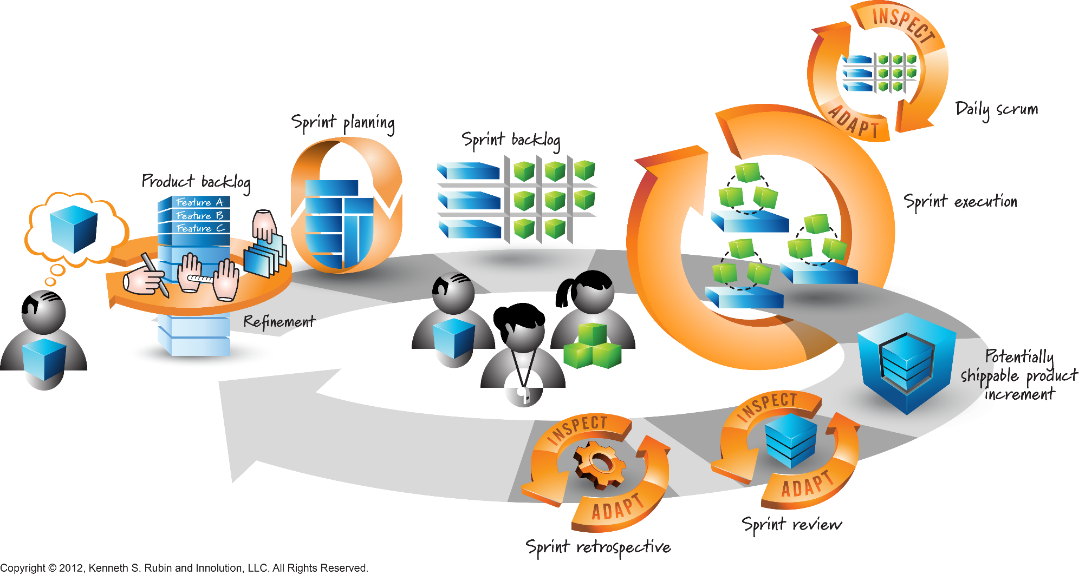
Scrum Overview

Slide 20
Sprint Planning – Determine Sprint Goal
Sprint Planning is done at the beginning of each sprint
This can be done the day before the sprint actually starts or the first day of the sprint, the team can decide
First part of sprint planning is to determine the sprint goal which is the product backlog items the team can commit to complete within the sprint
Product Owner is part of this meeting and provides answers to any questions regarding user stories
Scrummaster facilitates by reading the product backlog items that were allocated to the sprint. Team asks any questions that they need to
If a product backlog item is still not defined enough for the team to build it then it is moved back to the Product Backlog for another sprint

Slide 21
Sprint Planning – Define Sprint Backlog
Once the sprint goal is established then the team must decide who will work on each product backlog item. Based on the team multiple people may work on a product backlog item or just one person will work on the product backlog item
Team determines the person or persons to work on a product backlog item, no one outside of the team decides that. The Product Owner does not decide and the scrummaster does not decide
Once a team member or members select a product backlog item they break that product backlog item down into tasks to be completed and estimate number of hours or days to complete the tasks
The total number of hours or days associated with a product backlog item has no correlation to the number of story points since story points have no unit of measure
By having the team members pick the product backlog item they are going to work on and estimate the tasks they are committing to having that user story complete
The resulting tasks are the Sprint Backlog

Slide 22
Sprint Execution – Daily Standup or Daily Scrum
Once the sprint begins the team works collaboratively with the product owner and one another to finish product backlog items
There is a daily standup meeting for all team members each day. The product owner and scrummaster may attend but are not active participants
This meeting is called a daily standup as the team members may stand during the meeting to reduce the amount of time and the team should time box this meeting to 15 minutes
Each team member will answer: what did I do since yesterday, what am I going to do today, what are my roadblocks
The scrummaster will take note of the roadblocks and assist in clearing them
This is NOT a status meeting, it is not about the number of hours remaining or percent complete the person is on a task.

Slide 23
Sprint Review
At the end of each sprint there is time for the customer (product owner) to inspect
The sprint review typically happens on the last day of the sprint
The sprint review usually includes the team, product owner, scrummaster and can include stakeholders
Team facilitates the meeting by showing the product owner each product backlog item that was part of the sprint goal and how it was implemented
Product owner uses the acceptance criteria for the product backlog item to determine if the definition of DONE has been met
If product owner agrees the definition of DONE has been met for a product backlog item that product backlog item is completed
If product owner disagrees the definition of DONE has been met the product backlog item is put back into the product backlog and will be revisited in another sprint

Slide 24
Sprint Retrospective
The final inspect and adapt cycle for a sprint is the sprint retrospective
Sprint retrospective is for the team only, the scrummaster will attend but typically not the product owner. No other outside members should attend
The sprint retrospective is for the team to examine the current use of the scrum process and offer modifications or experiment with new ideas. Also this is a time to decide what has worked well for the team.
This is NOT a time to point fingers at others regarding performance during a sprint or to compare each person’s performance within the sprint
This is a time for the team to adapt for the future
Typically is done the same day as the sprint review
Come out of the sprint retrospective with action items to work on for the next sprint

Slide 25
Scrum Review
Scrum in 13 minutes
https://www.youtube.com/watch?v=4E-WP3pDms8&feature=emb_logo
Length 13:56
Length: 13:00

